Slide 1


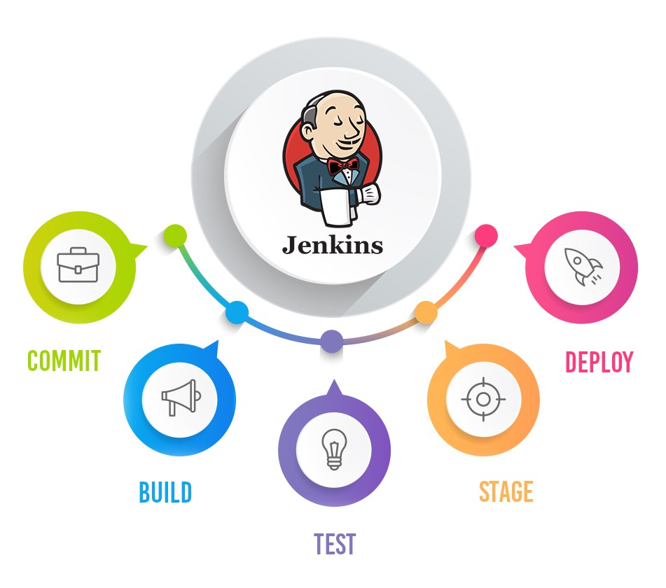
Jenkins Mastery for Software Tester
Pramod Dutta
Backup / HTML Reports in Jenkins

Slide 2

What we need to Backup HTML Report?
You need to save the result for future reference.
You need it for analyzing the graphs or failure trends.
Backing up the HTML Report and view in Frontend app if required else zipped.
Don’t want to keep the builds in jenkins

Slide 3
How to do it
Using a custom script to zip the dir and save in folder.
Using Amazon S3 plugin to upload it.
Using Periodic Back Up Plugin to backup Jenkins

